Slide 1
Input Convex Neural Networks
Brandon Amos Lei Xu* J. Zico Kolter Carnegie Mellon University School of Computer Science
*Tsinghua University, work done while at CMU
ICML 2017

Slide 2
Big picture
What are the “atomic operations” or building blocks of modern AI systems?
The current situation: Matrix-vector products (dense or sparse/structured), (sub)differentiable non-linear functions, random sampling
This talk: We should consider (convex) optimization as another potential atomic operation, to be composed with others
Note: we already use optimization in the learning procedures, but we should also consider it as an operation for inference and control
This is not a new idea: some of the original work in neural networks considered them composition with more complex, optimization-based prediction (c.f. structured prediction)

Slide 3
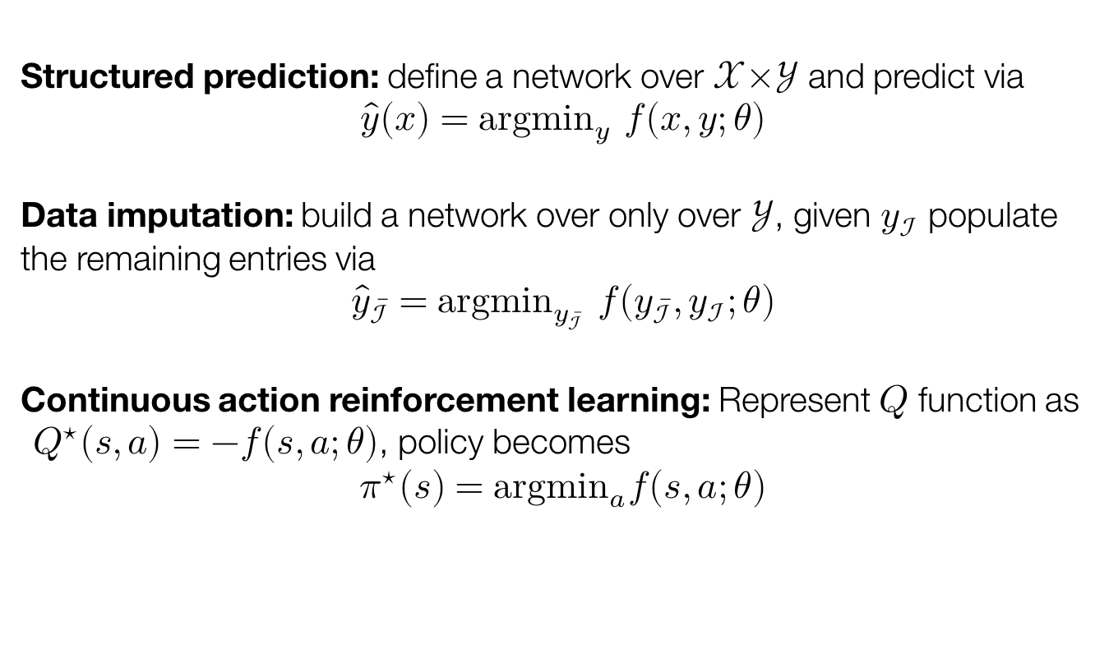
Applications of Optimization for Inference
Structured prediction: define a network over $𝒳×𝒴$ and predict via $$\hat{y}(x)={argmin}_{y} f(x,y;θ)$$
Data imputation: build a network over only over $𝒴$, given $y_{ℐ}$ populate the remaining entries via $${\hat{y}}_{\overline{ℐ}}={argmin}_{y_{\overline{ℐ}}} f\left(y_{\overline{ℐ}},y_{ℐ};θ\right)$$
Continuous action reinforcement learning: Represent $Q$ function as $Q^{⋆}\left(s,a\right)=−f(s,a;θ)$, policy becomes $$π^{⋆}\left(s\right)={argmin}_{a}f\left(s,a;θ\right)$$

Slide 4
Talk Overview
Our Contribution: Input Convex Neural Networks
Challenges: Inference and Learning
Experiments
Synthetic
Multi-label Classification
Image Completion
Continuous–Action Q-Learning

Slide 5
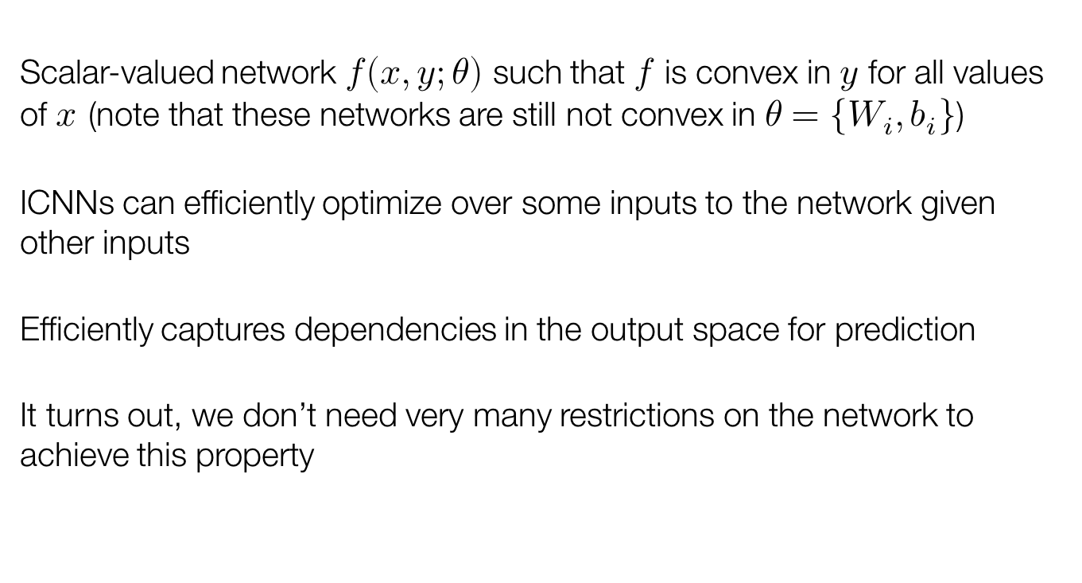
Input Convex Neural Networks (ICNNS)
Scalar-valued network $f(x,y;θ)$ such that $f$ is convex in $y$ for all values of $x$(note that these networks are still not convex in $θ=\{W_{i},b_{i}\}$)
ICNNs can efficiently optimize over some inputs to the network given other inputs
Efficiently captures dependencies in the output space for prediction
It turns out, we don’t need very many restrictions on the network to achieve this property
Notes:
Put model picture here

Slide 6
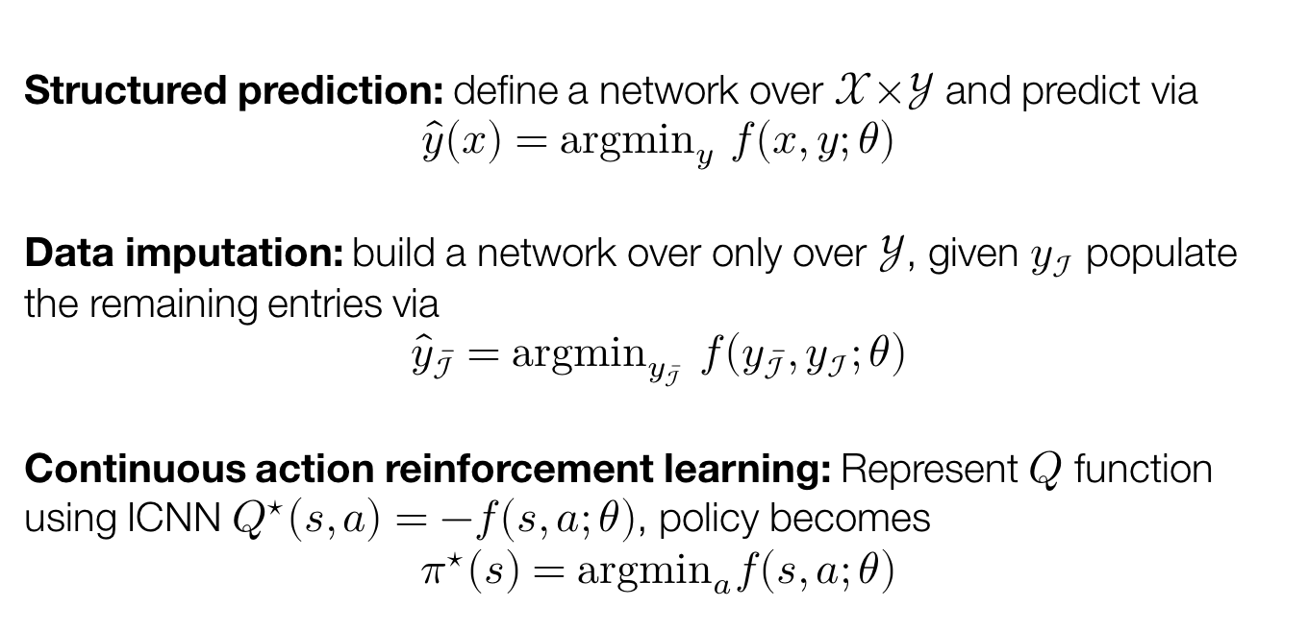
Applications of Optimization for Inference
With ICNNs: All of these problems are convex, “easy” to solve globally
Structured prediction: define a network over $𝒳×𝒴$ and predict via $$\hat{y}(x)={argmin}_{y} f(x,y;θ)$$
Data imputation: build a network over only over $𝒴$, given $y_{ℐ}$ populate the remaining entries via $${\hat{y}}_{\overline{ℐ}}={argmin}_{y_{\overline{ℐ}}} f\left(y_{\overline{ℐ}},y_{ℐ};θ\right)$$
Continuous action reinforcement learning: Represent $Q$ function using ICNN $Q^{⋆}\left(s,a\right)=−f(s,a;θ)$, policy becomes $$π^{⋆}\left(s\right)={argmin}_{a}f\left(s,a;θ\right)$$

Slide 7
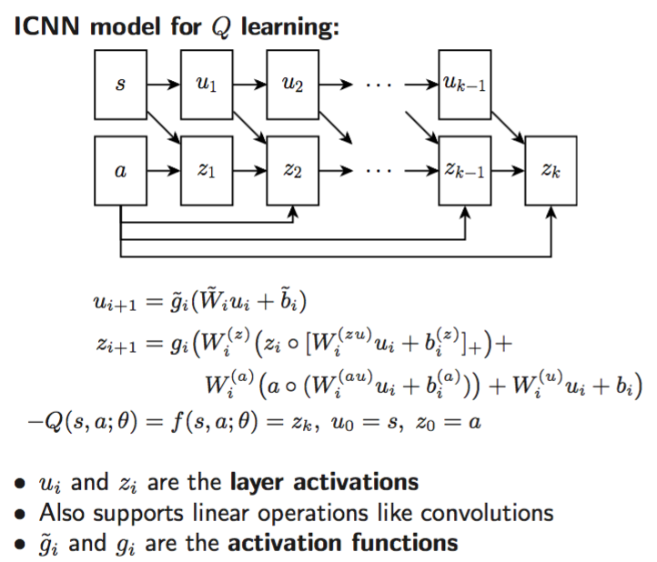
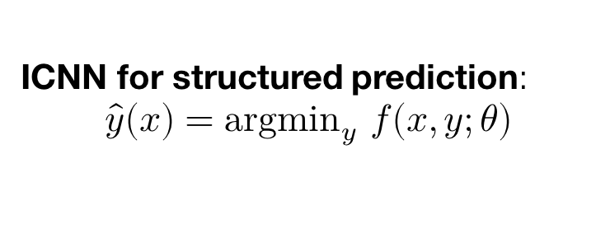
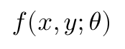
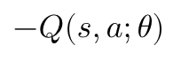
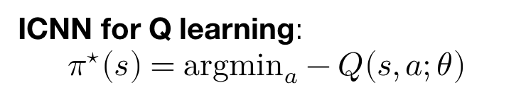
Example Networks
ICNN for structured prediction: $$\hat{y}(x)={argmin}_{y} f(x,y;θ)$$
ICNN for Q learning: $$π^{⋆}\left(s\right)={argmin}_{a}−Q\left(s,a;θ\right)$$
State
$$−Q(s,a;θ)$$
Features
$$f(x,y;θ)$$
Class
Prediction
Action

Slide 8
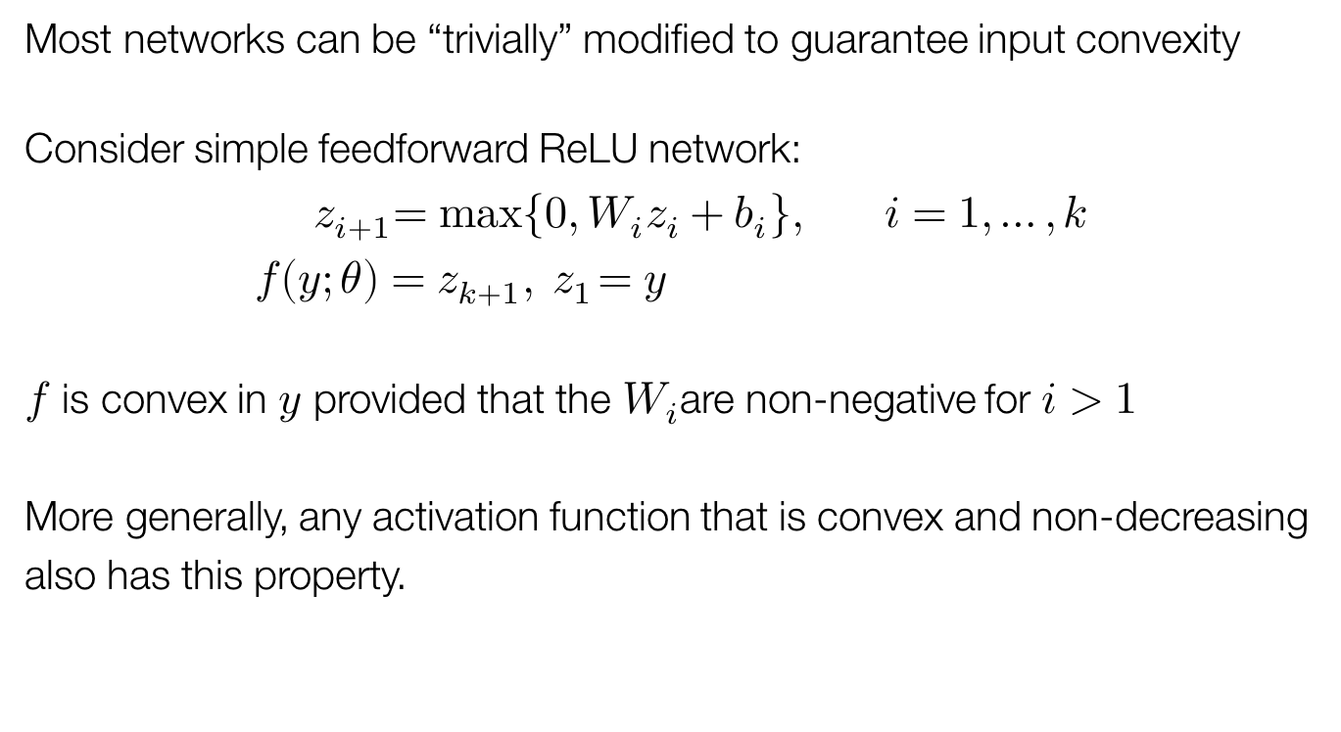
How to achieve input convexity?
Most networks can be “trivially” modified to guarantee input convexity
Consider simple feedforward ReLU network: $${ z}_{i+1}=max⁡\{0, W_{i}z_{i}+b_{i}\}, i=1,…,k \\ f\left(y;θ\right)=z_{k+1}, { z}_{1}=y$$
$f$ is convex in $y$ provided that the $W_{i}$are non-negative for $i>1$
More generally, any activation function that is convex and non-decreasing also has this property.
Notes:
Can be simplified

Slide 9
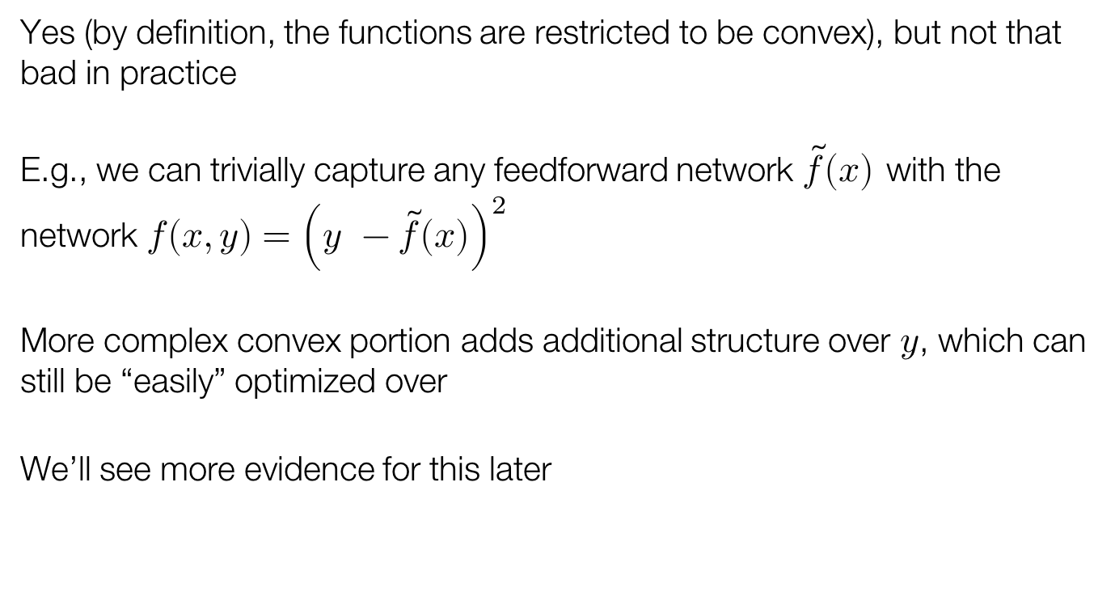
Is convexity restrictive?
Yes (by definition, the functions are restricted to be convex), but not that bad in practice
E.g., we can trivially capture any feedforward network $\tilde{f}\left(x\right)$with the network $f\left(x,y\right)={\left(y −\tilde{f}\left(x\right)\right)}^{2}$
More complex convex portion adds additional structure over $y$, which can still be “easily” optimized over
We’ll see more evidence for this later

Slide 10
Talk Overview
Our Contribution: Input Convex Neural Networks
Challenges: Inference and Learning
Experiments
Synthetic
Multi-label Classification
Image Completion
Continuous–Action Q-Learning

Slide 11
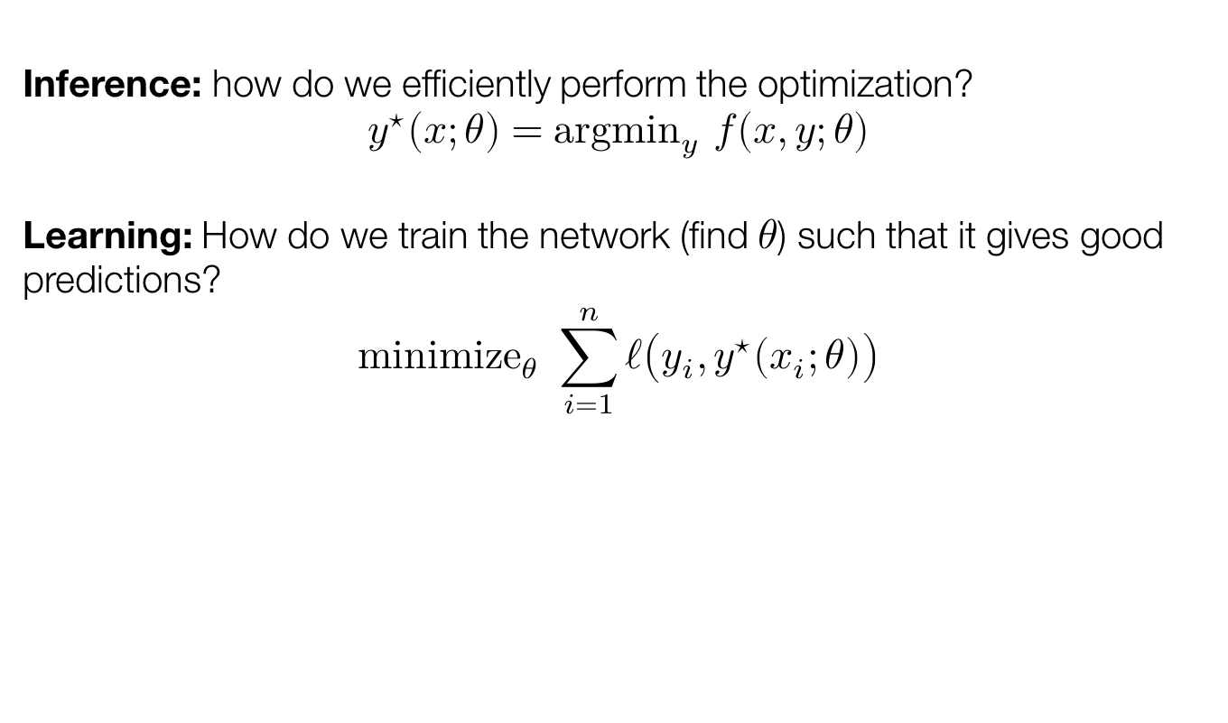
Challenges for ICNNs
Inference: how do we efficiently perform the optimization?
$${y^{⋆}\left(x;θ\right)=argmin}_{y} f(x,y;θ)$$
Learning: How do we train the network (find $θ$) such that it gives good predictions? $${minimize}_{θ} \sum_{i=1}^{n}{ℓ\left(y_{i}, y^{⋆}\left(x_{i};θ\right)\right)}$$

Slide 12
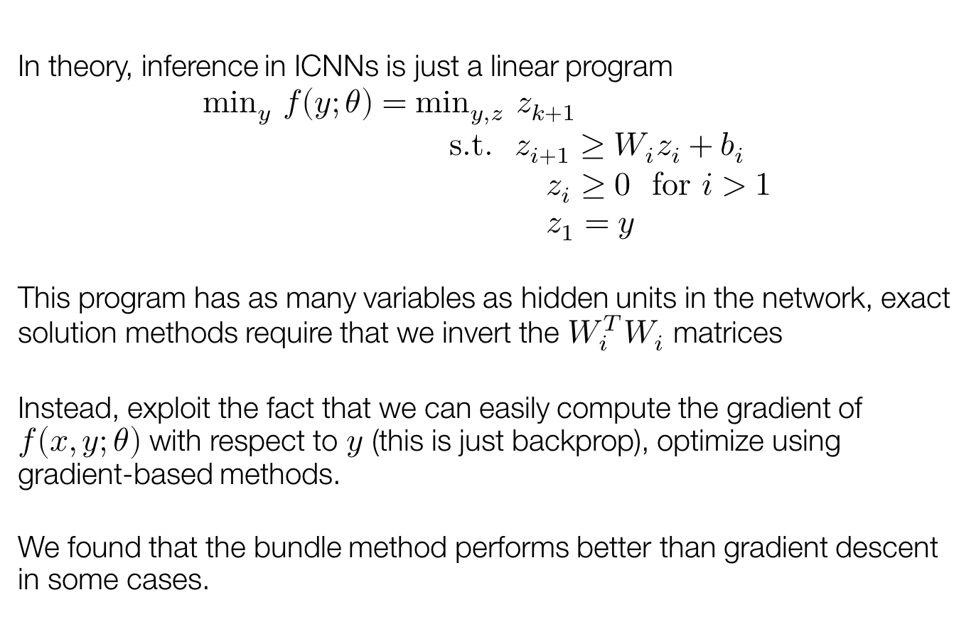
Inference in ICNNs
In theory, inference in ICNNs is just a linear program
$$\min_{y} f\left(y;θ\right)=\min_{y,z} z_{k+1} \\ \text{s}\text{.}\text{t}\text{. }z_{i+1}≥W_{i}z_{i}+b_{i} \\ z_{i}≥0 \text{for} i>1 \\ z_{1}=y$$
This program has as many variables as hidden units in the network, exact solution methods require that we invert the $W_{i}^{T}W_{i}$ matrices
Instead, exploit the fact that we can easily compute the gradient of $f\left(x,y;θ\right)$ with respect to $y$ (this is just backprop), optimize using gradient-based methods.
We found that the bundle method performs better than gradient descent in some cases.

Slide 13
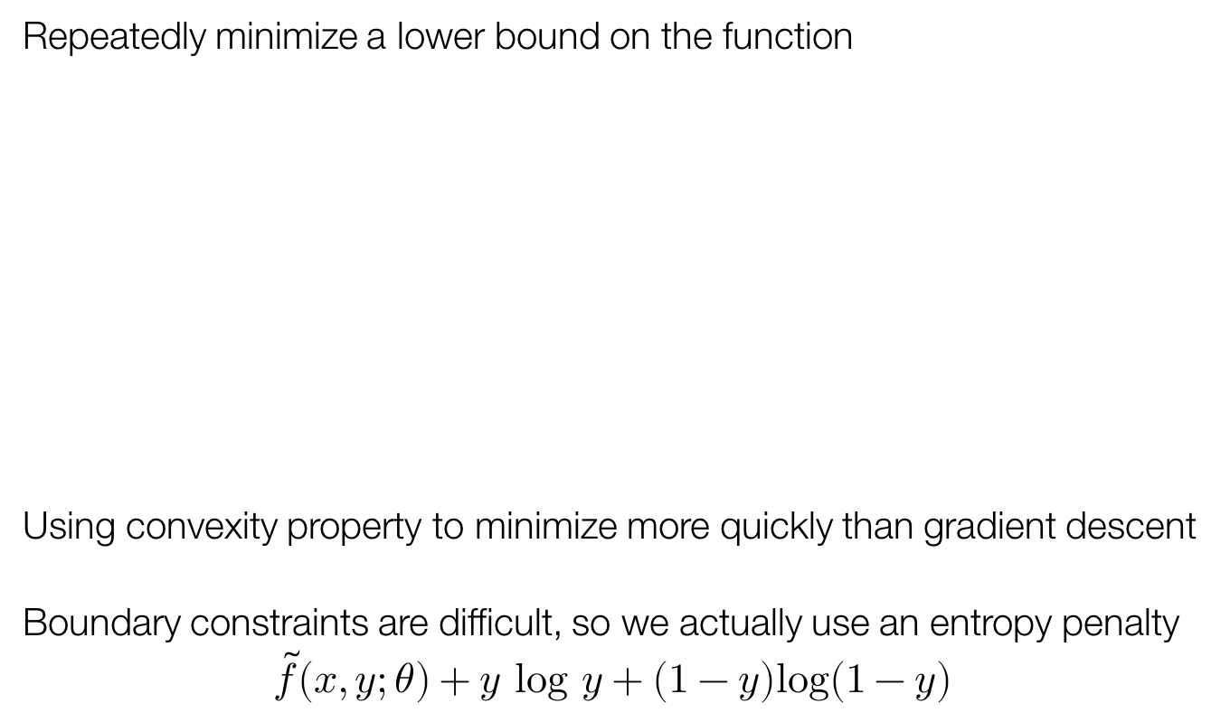
Inference with the Bundle Method
Repeatedly minimize a lower bound on the function
Using convexity property to minimize more quickly than gradient descent
Boundary constraints are difficult, so we actually use an entropy penalty $$\tilde{f}\left(x,y;θ\right)+y log y+\left(1−y\right)log(1−y)$$

Slide 14
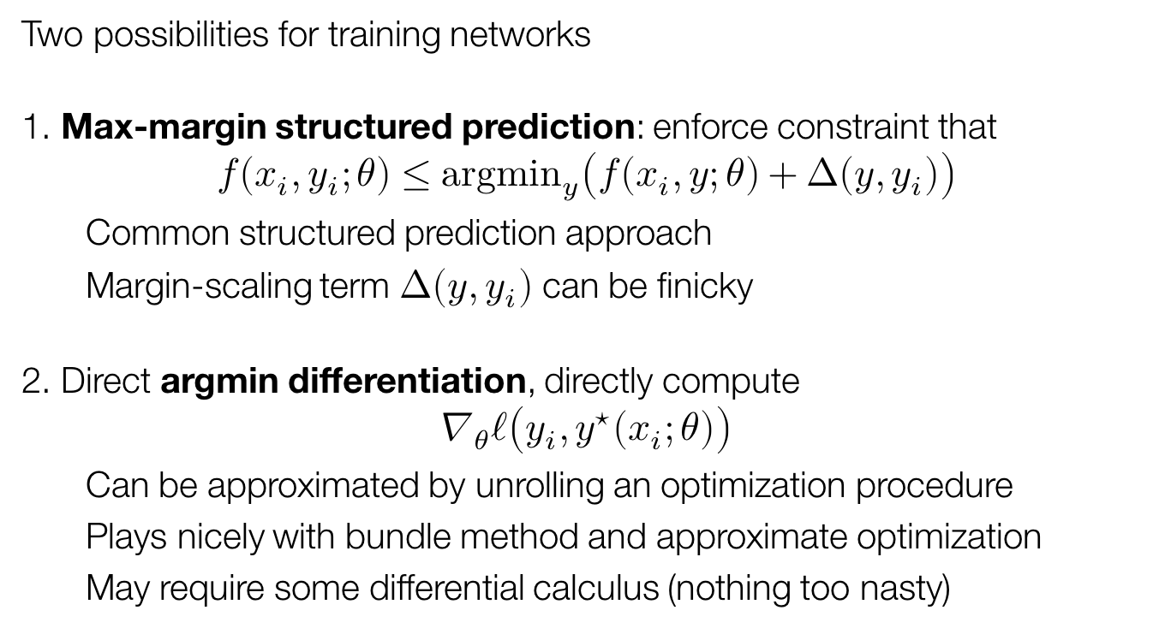
ICNN Learning
Two possibilities for training networks
1. Max-margin structured prediction: enforce constraint that
$$f\left(x_{i}, y_{i};θ\right)≤{argmin}_{y}\left(f\left(x_{i},y;θ\right)+Δ\left(y,y_{i}\right)\right)$$
Common structured prediction approach
Margin-scaling term $Δ(y, y_{i})$ can be finicky
2. Direct argmin differentiation, directly compute
$$∇_{θ}ℓ\left(y_{i}, y^{⋆}\left(x_{i};θ\right)\right)$$
Can be approximated by unrolling an optimization procedure
Plays nicely with bundle method and approximate optimization
May require some differential calculus (nothing too nasty)

Slide 15
Talk Overview
Our Contribution: Input Convex Neural Networks
Challenges: Inference and Learning
Experiments
Synthetic
Multi-label Classification
Image Completion
Continuous–Action Q-Learning

Slide 16
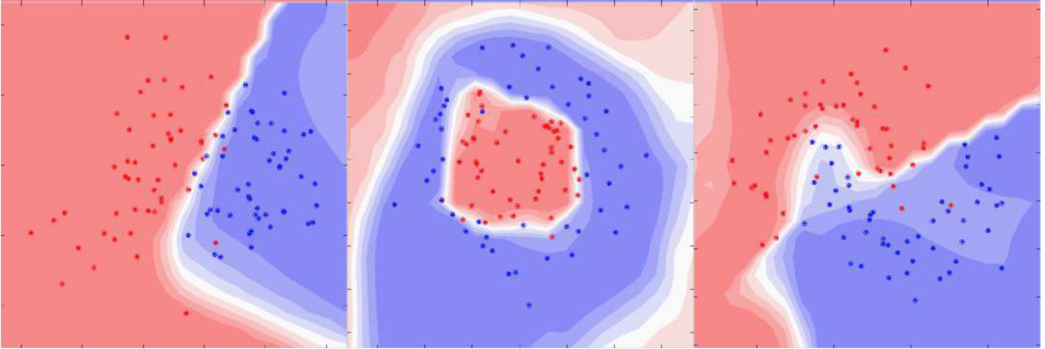
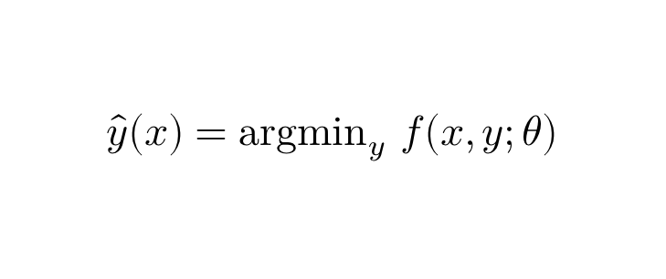
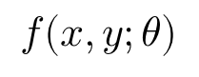
Results: toy example
Partially input convex neural network trained to classify points in 2D space
Only point to remember from this: convex energy function does not imply a convex decision boundary; argmin operator is a powerful one
$$\hat{y}(x)={argmin}_{y} f(x,y;θ)$$
Features
Class Prediction
$$f(x,y;θ)$$

Slide 17
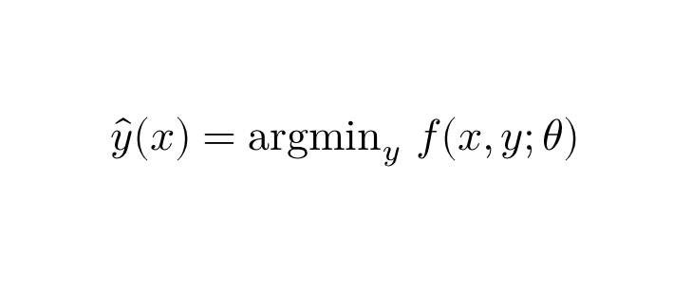
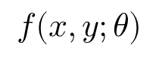
Results: multi-label classification
Task: Predict tags for bibtex entries from bag of words features
Used in Belanger and McCallum, 2016: Structured Prediction Energy Networks
ICNNs almost recover the same performance as SPENs despite the convexity restrictions
$$\hat{y}(x)={argmin}_{y} f(x,y;θ)$$
Method | Test Macro-F1
NN (Baseline) | 0.396
SPEN | 0.422
ICNN | 0.415
Features
$$f(x,y;θ)$$
Class
Prediction

Slide 18
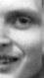
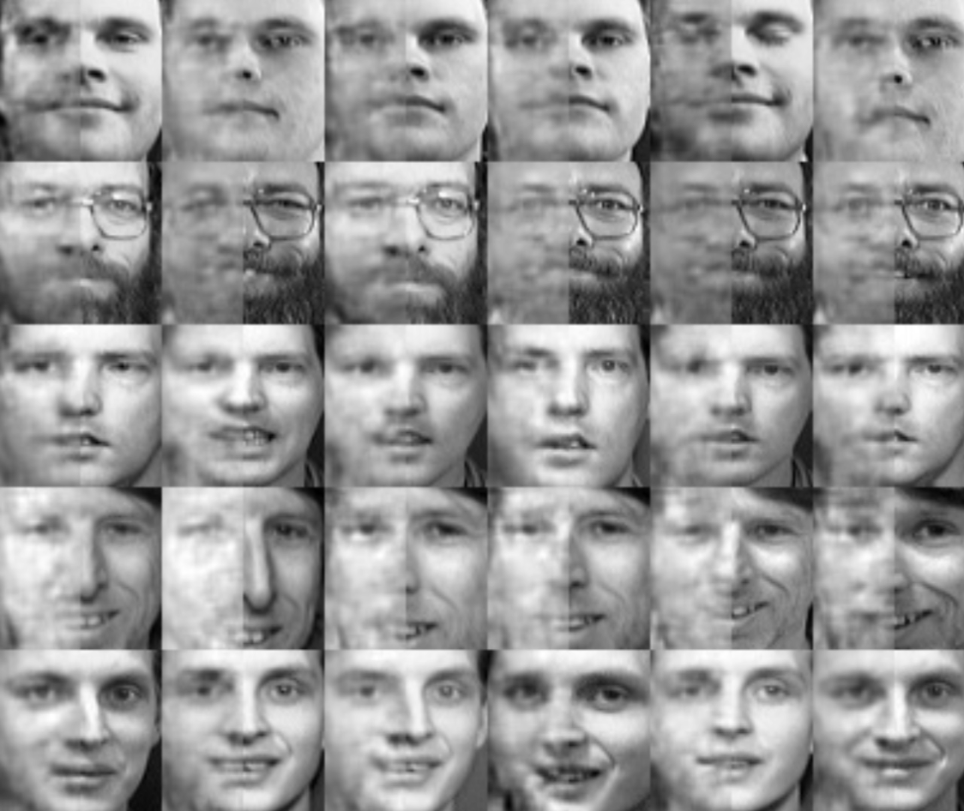
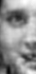
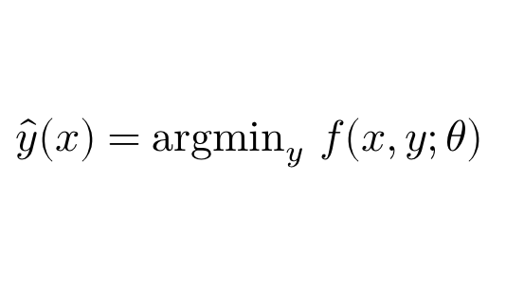
Results: image completion
Task: Predict the left side of the image given the right side. Used in Poon and Domingos 2011; Sum-Product Networks
ICNN: DQN-like network over both input and output
$$\hat{y}(x)={argmin}_{y} f(x,y;θ)$$
ICNN Test Set Completions
(Given) Right
Face Half
(Predicted) Left
Face Half
$$f(x,y;θ)$$
Method | MSE
SPN | 942
ICNN: Bundle Entropy | 833.0
ICNN: Gradient Descent | 872.0
ICNN: Non-convex (GD) | 850.9
Notes:
Show network with images

Slide 19
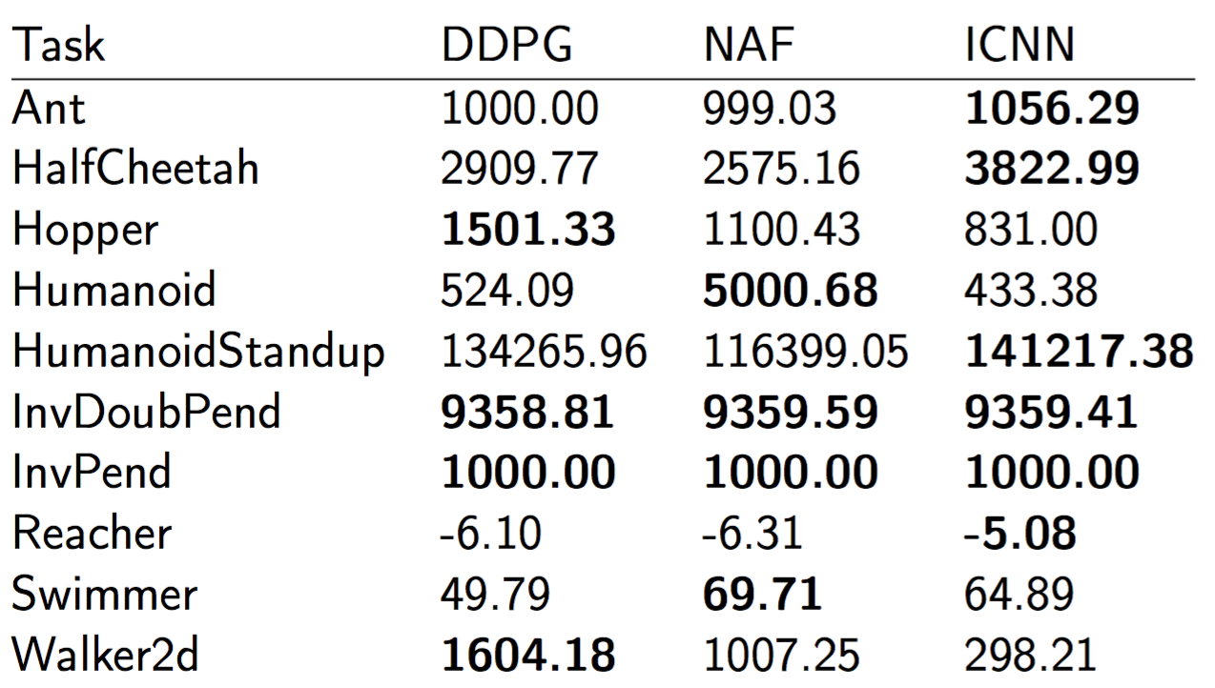
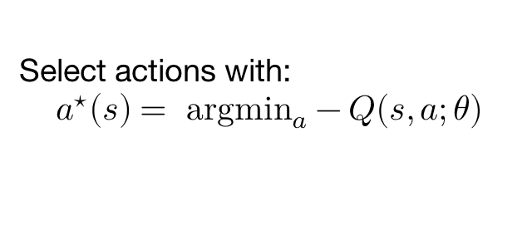
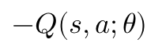
Results: continuous-action RL
Using Q-learning with entropy-regularized ICNN to represent Q function.
Comparing to DDPG [Lillicrap et al., 2016], and NAF [Gu et al., 2016]
NAF is particularly similar: also uses a value function that is convex in the input, but uses a quadratic representation to guarantee this convexity
Table: Max (rolling) test reward obtained on Gym continuous control tasks
Select actions with:
$$a^{⋆}\left(s\right)= {\text{argmin}}_{a}−Q(s, a;θ)$$
State
$$−Q(s,a;θ)$$
Action

Slide 20
Input Convex Neural Networks
Brandon Amos Lei Xu J. Zico Kolter Carnegie Mellon University School of Computer Science
Our Contribution: Input Convex Neural Networks
Challenges: Inference and Learning
Experiments
Synthetic
Multi-label Classification
Image Completion
Continuous–Action Q-Learning
The full TensorFlow source code to reproduce all of our experiments is available online at https://github.com/locuslab/icnn

